Slide 1
Evaluating Models Part 1
Evaluation is Creation
Geoff Hulten

Slide 2
Training and Testing Data
1) Training set: to build the model
2) Validation set: to tune the parameters of the model
3) Test set: to estimate how well the model works
Common Pattern:
for p in parametersToTry:
model.fit(trainX, trainY, p)
accuracies[p] = evaluate(validationY, model.predict(validationX))
bestPFound = bestParametersFound(accuracies)
finalModel.fit(trainX+validationX, trainY+validationY, bestPFound)
estimateOfGeneralizationPerformance = evaluate(testY, finalModel.predict(testX))

Slide 3
Risks with Evaluation
Failure to Generalize:
1) If you test on the same data you train on, you’ll be too optimistic
2) If you evaluate on test data a lot as you’re debugging, you’ll be too optimistic
Failure to learn the best model you can:
3) If you reserve too much data for testing you might not learn as good a model

Slide 4
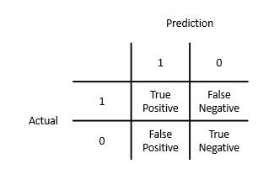
Types of Mistakes: Confusion Matrix
Actual | Prediction
0 | 1
0 | 1
0 | 1
0 | 0
0 | 0
1 | 0
1 | 0
1 | 1
1 | 1
1 | 1

Slide 5
Basic Evaluation Metrics
Actual | Prediction
0 | 1
0 | 1
0 | 1
0 | 0
0 | 0
1 | 0
1 | 0
1 | 1
1 | 1
1 | 1
Accuracy: What fraction does it get right
(# TP + # TN) / # Total
Precision: When it says 1 how often is it right
# TP / (# TP + # FP)
Recall: What fraction of 1s does it get right
# TP / (# TP + # FN)
False Positive Rate: What fraction of 0s are called 1s
# FP / (# FP + # TN)
False Negative Rate: What fraction of 1s are called 0s
# FN / (# TP + # FN)
3
2
3
2

Slide 6
Example of Evaluation Metrics
Accuracy: 91%
(# TP + # TN) / # Total
False Negative Rate: 0%
# FN / (# TP + # FN)
False Positive Rate: 90%
# FP / (# FP + # TN)
90
0
9
1

